Slide 1
Sustainability challenges in developing research software for sharing data
Asif Imran, Ph.D Candidate
University at Buffalo (SUNY)
And
Dr. Tevfik Kosar, Associate Profesor,
University at Buffalo (SUNY)

Slide 2
Overview
Vision of OneDataShare
Challenges faced in sustaining OneDataShare
Feedback from developers to meet these challenges
References

Slide 3
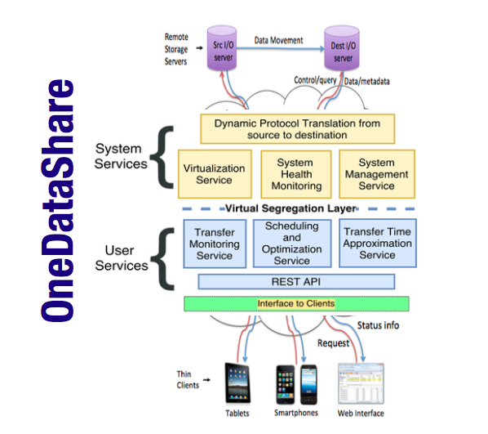
Vision of OneDataShare
Managed File Transfers have been increasingly gaining popularity in research arena due to the increase in volume of data being shared amongst researchers across the world.
With an aim to provide a platform to the researchers via which they can communicate large volumes of data in shortest possible time, we design state of the art research software called OneDataShare [Imran et.al.].
Goal: reducing time of delivery and increasing focus on conducting research with the data

Slide 4
Vision of OneDataShare
To help research community transfer data faster and remove the hassle of waiting for its arrival for a long time, OneDatashare
Uses machine learning techniques like adaptive sampling to speedup data transfers
Deploys historical analysis and real time tuning
Ensures energy efficient data transfers [Nine et.al.]
Allowing researchers to fine tune their priorities and goals in the data transfer process
Energy aware data transfer solution for the researchers.

Slide 5
Challenges faced
The challenges can be broadly divided into software design, implementation and maintenance phases. Broadly, it can be categorized as:
Time spent on re-inventing the wheel
Lack of proper documentation
Integrating third party components so that they sustain
Lack of training and unavailability of learning materials on third party technologies (for e.g. GridFTP)
User experience
Open source software: Lacking in community support

Slide 6
Time spent on re-inventing the wheel
Developed and driven by research and student community
Significant developer’s time were spent on identifying what previous teams have done.
Re-generate previous results in terms of throughputs of data transfers and comparing those with latest updates became a challenge.
Using DevOps for managing the project is being explored at this time [Jimenez et. al].

Slide 7
Lack of documentation
Although followed vastly in the industry, lack of proper documentation is still an issue for many cases research software development.
Research conducted in [Katerbow et. al.] suggest that excessive documentation does not guarantee good software development. Their assumption can be generalized to research software as well.
Too much documentation or lack of it threatened the sustainability of OneDataShare. The guidelines outlined by [Wilson et, al.] to achieve elegant documentation can be considered.

Slide 8
Sustainable integration of third party components
To aid research community, OneDataShare integrates many third party data storage application interfaces and protocols at the backend. These storage interfaces include Google Drive, DropBox and GrdFTP. Protocols include FTP, SFTP, TCP, HTTP, SMTP, etc.
These application interfaces often become obsolete and new versions need to be included. The constant management of this up-gradation process presents sustainability challenges.
OneDataShare team is trying to manage the integration challenge in sustainable manner.

Slide 9
Learnings
Follow full project management processes despite the fact that it is a research software
Dynamic leadership from project director is critical to its sustainability [Stewart et. al.]
Useful high level documentation
Developing mechanisms to quickly re-generate previous results
Improved training
Continued Funding

Slide 10
Learnings [cont]
Knowledge sharing via events to come across useful ideas and experiences
Industry and research community collaboration to build effective research software
Patterns and principles
Shared understanding
Code review
Incremental development

Slide 11
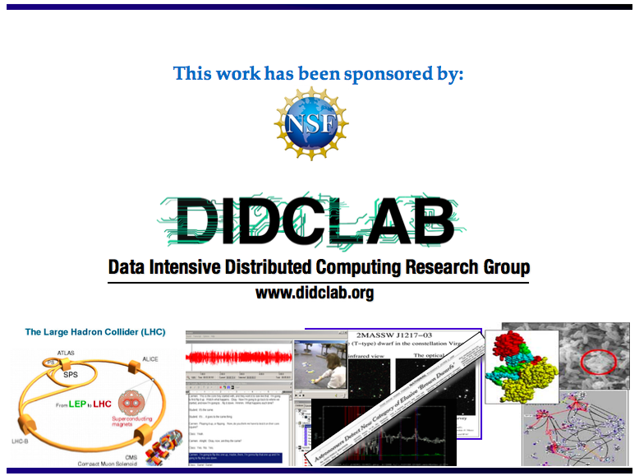
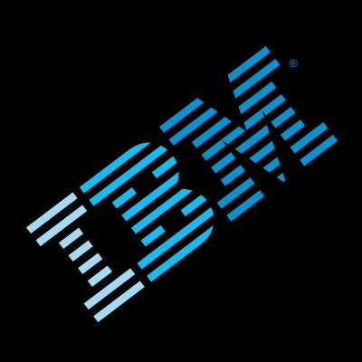

Slide 12
Acknowledgement
This project is in part sponsored by the National Science Foundation (NSF) under award number OAC-1724898.
We also would like to thank Siddharth Ravikumar, , Yifu Yin, Javier, Shreya Hegde, Linus Castelino, Pooja Shingavi, Atul Sing, Sarang Agarwal and Praveen Kumar Rajendran for their contributions in the implementation of this project.

Slide 13
References
Imran, Asif, et al. "OneDataShare-A Vision for Cloud-hosted Data Transfer Scheduling and Optimization as a Service [OneDataShare-A Vision for Cloud-hosted Data Transfer Scheduling and Optimization as a Service]." Proceedings of the 8th International Conference on Cloud Computing and Services Science. Vol. 1. 2018.
Nine, M. D., Luigi Di Tacchio, Asif Imran, Tevfik Kosar, M. Fatih Bulut, and Jinho Hwang. "GreenDataFlow: Minimizing the Energy Footprint of Global Data Movement." arXiv preprint arXiv:1810.05892 (2018).
M. Katerbow, G. Feulner, M. Bornschein, B. Brembs, M. Erben-Russ, K. Förstner, M. Franke, B. Fritzsch, J. Fuhrmann, M. Goedicke, et al. Recommendations on the development, use and provision of research software, 2018.
G. Wilson, J. Bryan, K. Cranston, J. Kitzes, L. Nederbragt, and T. K. Teal. Good enough practices in scienti c computing. PLoS computational biology, 13(6):e1005510, 2017.
Jimenez, Ivo, Michael Sevilla, Noah Watkins, Carlos Maltzahn, Jay Lofstead, Kathryn Mohror, Andrea Arpaci-Dusseau, and Remzi Arpaci-Dusseau. "The popper convention: Making reproducible systems evaluation practical." In Parallel and Distributed Processing Symposium Workshops (IPDPSW), 2017 IEEE International, pp. 1561-1570. IEEE, 2017.

Slide 14
References
J. Kitzes, D. Turek, and F. Deniz. The practice of reproducible research: case studies and lessons from the data-intensive sciences. Univ of California Press, 2017.
Stewart, Craig A., William K. Barnett, Eric A. Wernert, Julie A. Wernert, Von Welch, and Richard Knepper. "Sustained Software for Cyberinfrastructure: Analyses of Successful Efforts with a Focus on NSF-funded Software." In Proceedings of the 1st Workshop on The Science of Cyberinfrastructure: Research, Experience, Applications and Models, pp. 63-72. ACM, 2015.

